Slide 1

Capstone
Data Forces
P-7 Sleep Inducer
Team members
Neel Gamit-202301469
Vishal Joliya-202301199
Farzan Bhalara-202301248
Udita Chatwani-202304011
Mahir Shah-202304026
https://github.com/MahirShah2005/Sleep_inducer.git

Slide 2
Problem statement
You are to build a Sleep Inducer.
Our c++ code is designed to simulate a scenario where inmates are assigned to dorms and each of them are subject to a music channel having songs.
Each of the inmates have their sleeping time and duration to fall asleep. Each of them are provided with earpord which will play music at their respective sleeping time until they fall asleep.
https://drive.google.com/file/d/1Xkv4qRhnyq5TKcDPeNeY9yJg9C-Ydu3R/view?usp=sharing

Slide 3
Data Structures chosen
Vectors
Vectors are used to store lists of objects (inmates and dorms) because they provide dynamic resizing, efficient access to elements, and support for various operations such as adding, removing, and accessing elements by index.
Queues
Queues are used to represent the playlist of sleep-inducing music for each dorm because they ensure that songs are played in the order they were added (FIFO). This is desirable for playing music in a continuous sequence without interruptions or out-of-order playback.

Slide 4
Time complexity
Reading Input Data: The time complexity of reading input data from a text file is ( O(n) ), where ( n ) is the number of lines in the input file.
Assigning Inmates to Dorms: The time complexity of assigning inmates to dormitories depends on the number of inmates (( m )) and the number of dormitories (( k )). It is ( O(m + k) ).
Playing Sleep-Inducing Music: The time complexity of playing sleep-inducing music in dormitories depends on the number of inmates (( m )) and the number of music channels (( c )) available in each dormitory. It is ( O(m x c) ).

Slide 5
Space complexity
Inmates and Dormitories Data:
The space complexity for storing the inmates and dormitories data depends on the number of inmates and dormitories, respectively. Let (N) be the number of inmates and ( M ) be the number of dormitories. Therefore, the space complexity for storing inmates and dormitories data is ( O(N + M) ).
Active Music Channels:
The space complexity for storing active music channels depends on the number of unique music channels being played simultaneously across all dormitories.
In the worst case, all music channels in all dormitories could be active simultaneously. Let ( c ) be the maximum number of music channels in a dormitory. Therefore, the space complexity for storing active music channels is ( O(c) ).

Slide 6
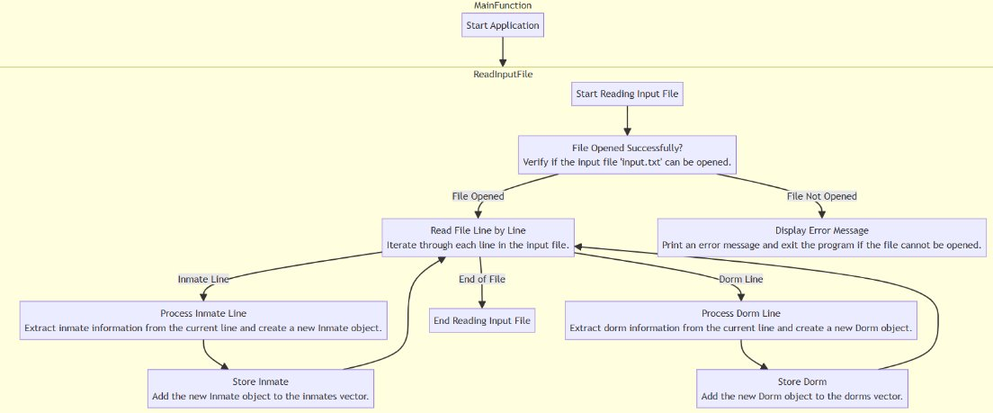

Slide 7
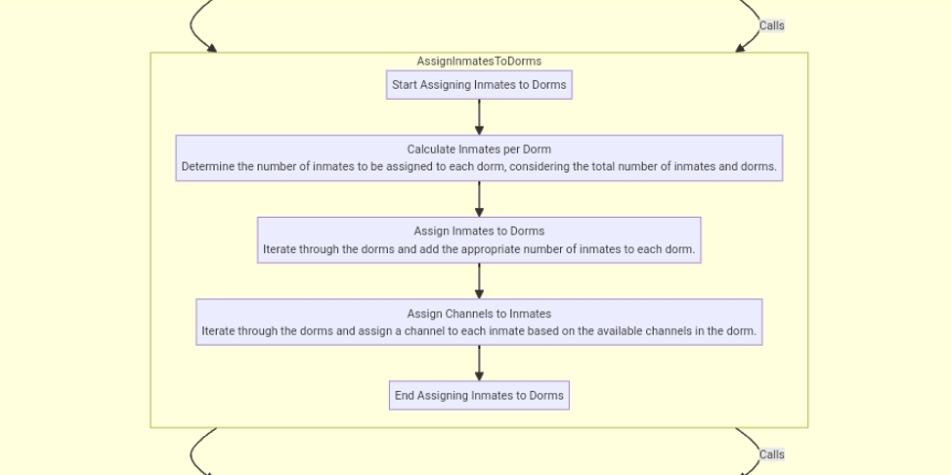

Slide 8
